Slide 1
ELECTRIC MOTOR TEMPERATURE PREDICTION
Group-2
Members:
Pooja Rani Nayak
Mrudulaiswarya Subha Vyakaranam
Venkata Sandeep Pesala
Sagar Mahadev Panchal
Mani Aditya Tellakula
Prabhu Kumar Sambar
Sandeep Kumar Balaga
Mentor
Ritesh

Slide 2
About Permanent Magnet Synchronous Motor
A permanent magnet synchronous motor (PMSM) - is a synchronous electric motor whose inductor consists of permanent magnets.
PMSM is a cross between an induction motor and a brushless DC motor with a higher power density than an induction motor. Due to their advantages, permanent synchronous motors are a very popular solution in electrical drives.
The principle of operation of a synchronous motor is based on the interaction of the rotating magnetic field of the stator and the constant magnetic field of the rotor.

Slide 3
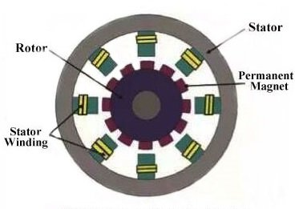
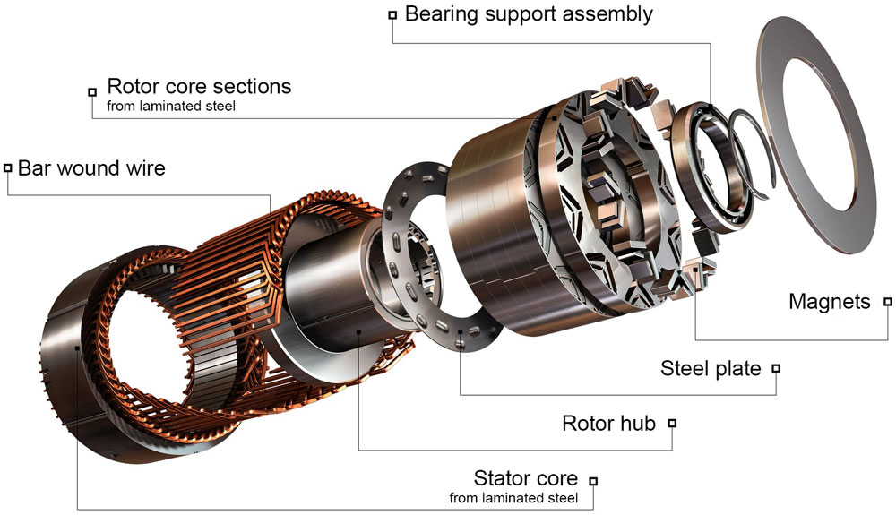

Slide 4
Business problem
To find the Temperature of the Motor
Objective
The goal of the Project is to Predict the Temperature of the motor based on several sensor data

Slide 5
PROJECT FLOW

Slide 6
Exploratory Data Analysis
[EDA]

Slide 7
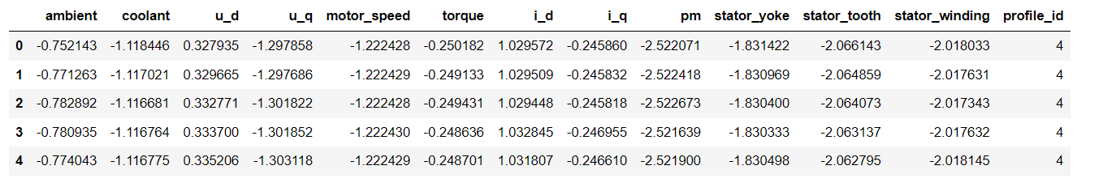

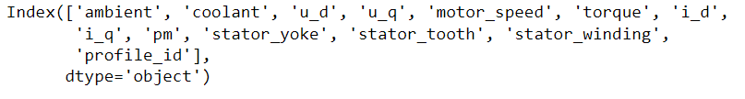
DATA
DATA SHAPE
DATA COLUMNS

Slide 8
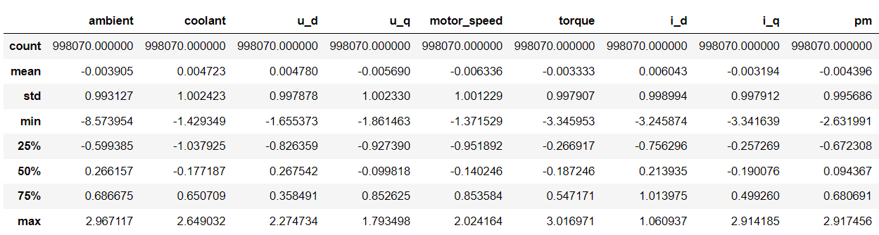
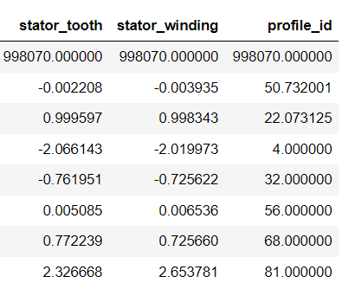
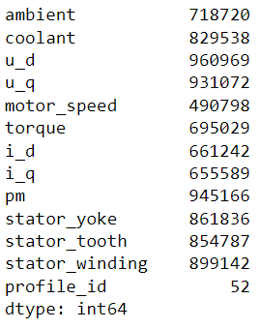
DATA CHARACTERISTICS
UNIQUE VALUES

Slide 9
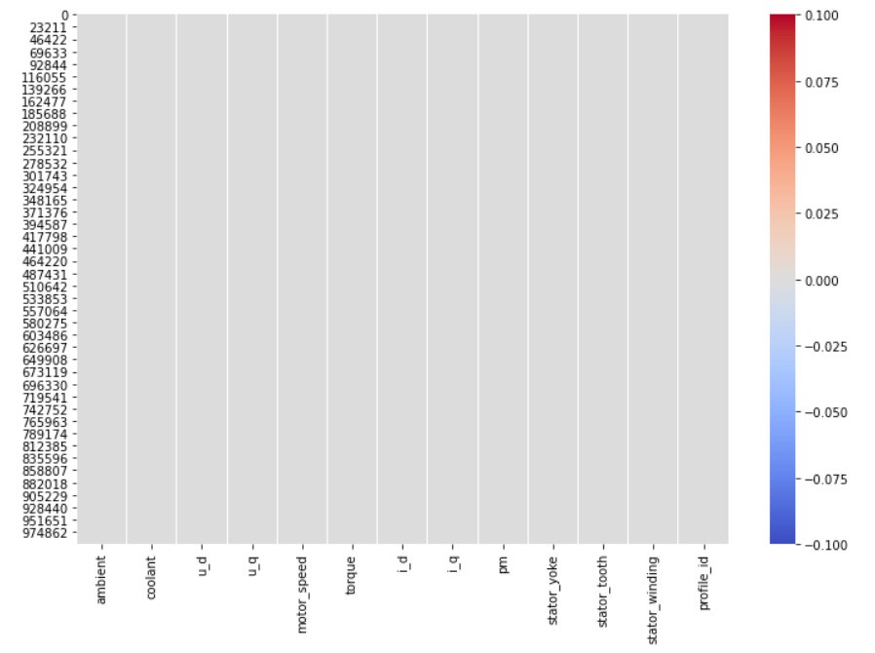
CHECKING FOR NULL VALUES

Slide 10
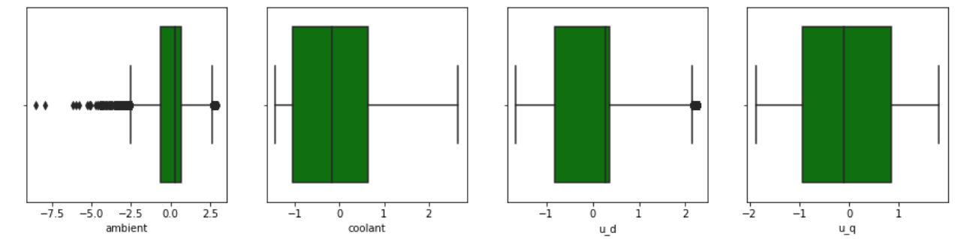
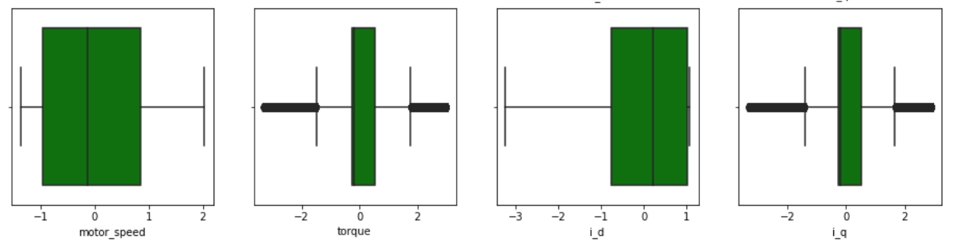
CHECKING FOR OUTLIERS
Variables ‘Ambient’,’ u_d’, ‘torque’,’i_q’ have outliers

Slide 11
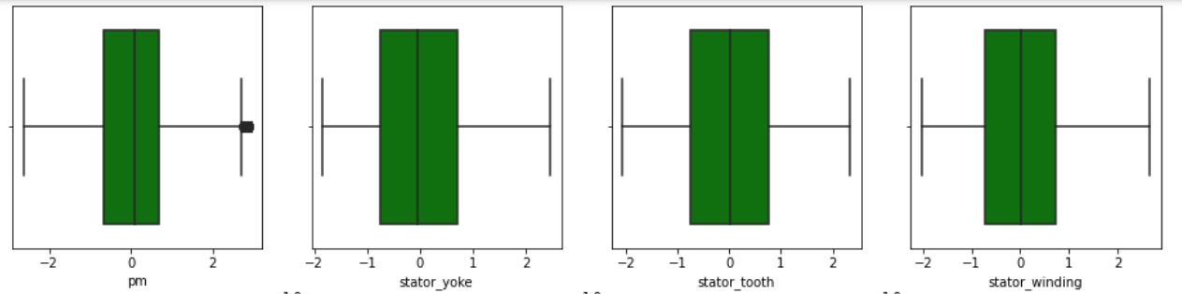
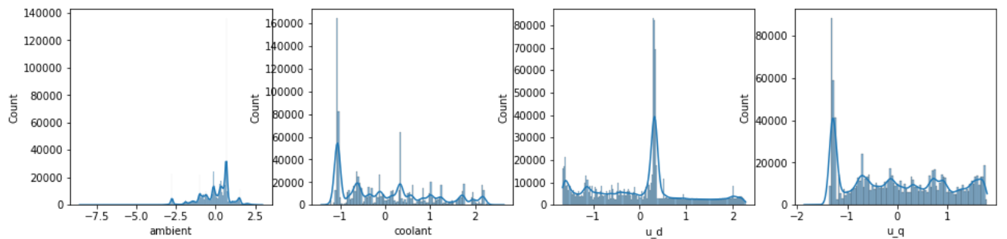
CHECKING THE DISTRIBUTION OF THE DATA

Slide 12
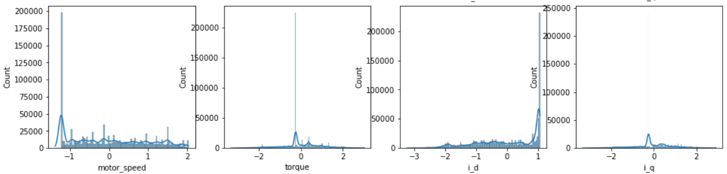
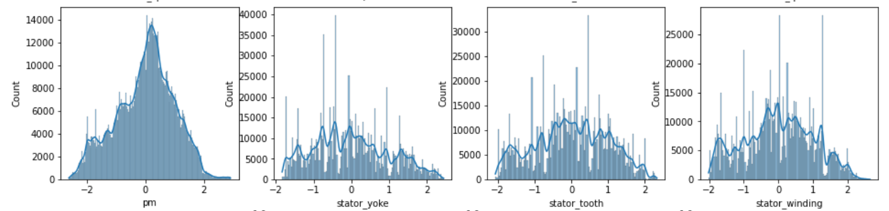
The Data is Normally Distributed

Slide 13
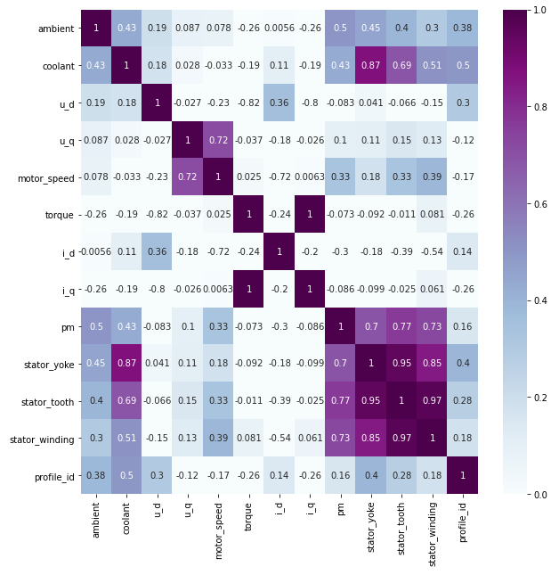
CHECKING THE CORELATION BETWEEN TARGET AND OTHER VARIABLES

Slide 14
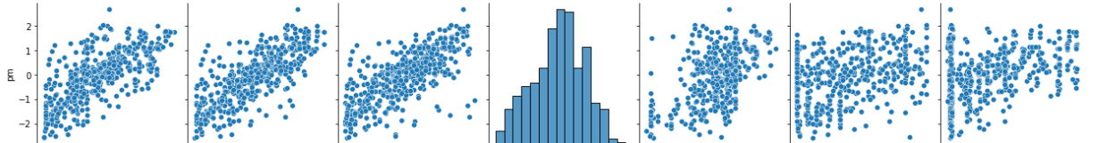
PAIR PLOT

Slide 15
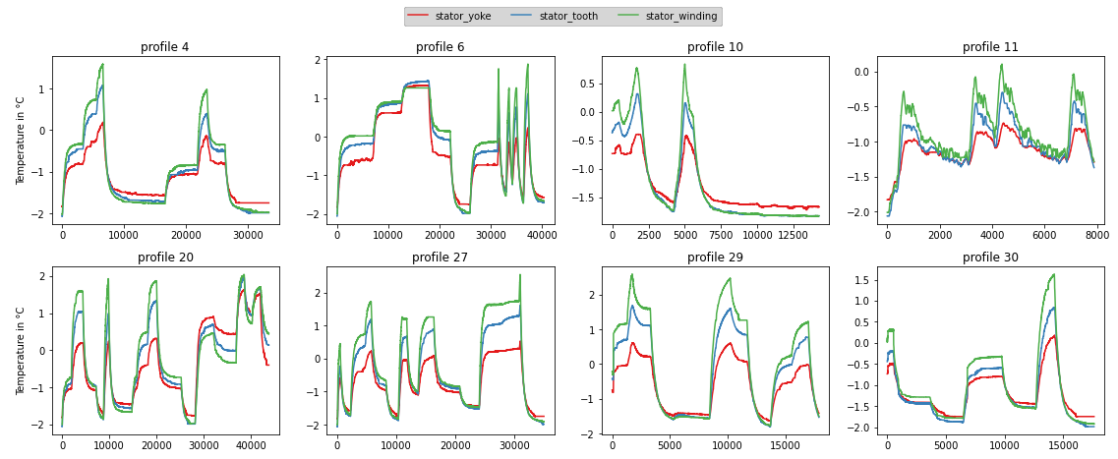
Relation Between stator_yoke, stator_tooth and stator_winding for Each Individual Session
From the above graphs we can infer that all the temperatures follow similar pattern

Slide 16
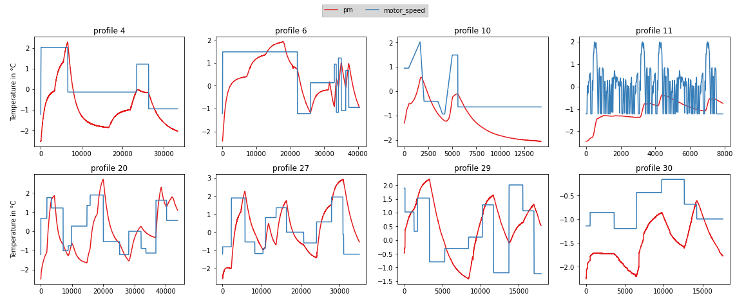
Relation Between ‘Pm’ And ‘motor_speed’ for Each Individual Session
PM and motor_speed have a strong correlation

Slide 17
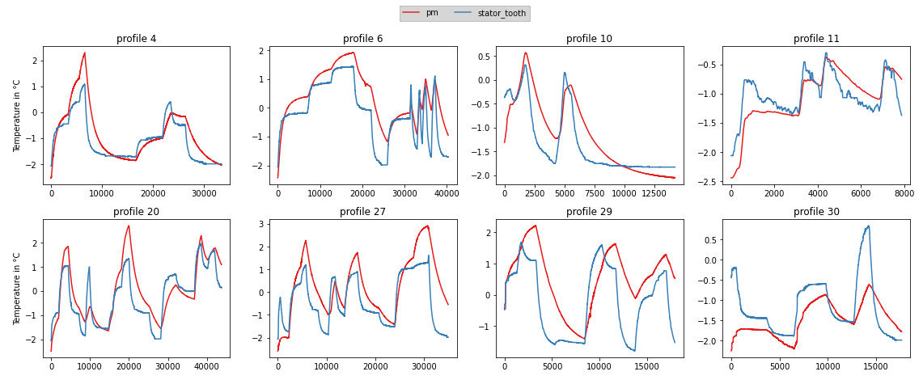
Relation Between ‘Pm’ And ‘Stator_tooth’ for Each Individual Session
PM and Stator_tooth have strong correlation

Slide 18
Feature Engineering

Slide 19
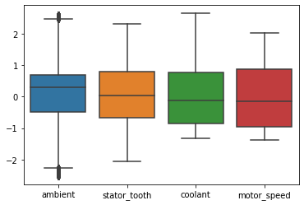
Removing Outliers

Slide 20
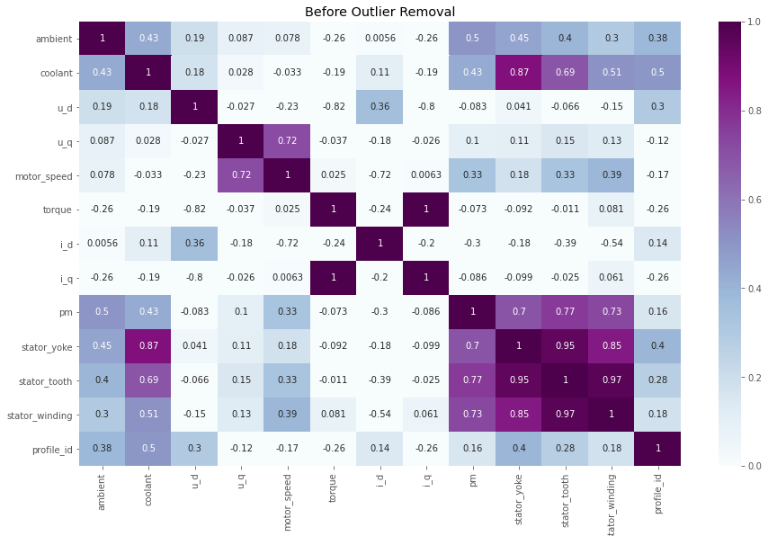
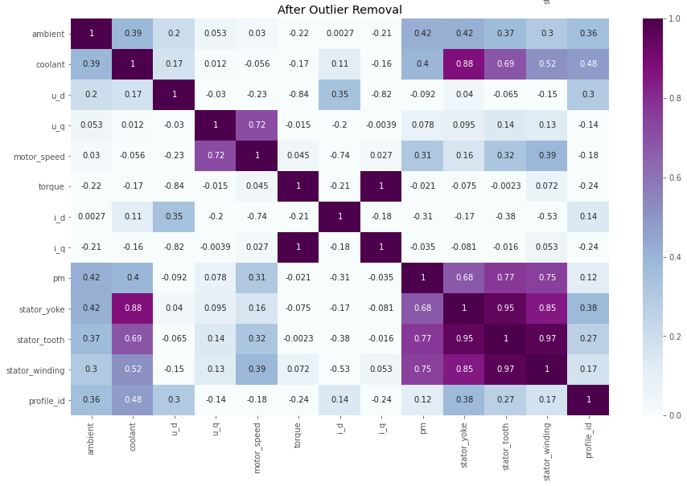
Heat Map
Data Shape
(959578,13)

Slide 21
Model Building

Slide 22
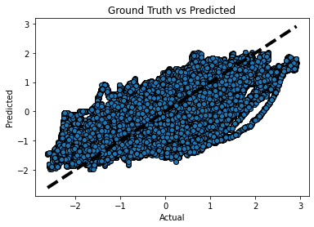
Linear Regression Model
Train Accuracy :66.2260605064275
Test Accuracy :66.27734294541347
Accuracy :66.27734294541347
RMSE Value :0.5525094823472219
MAE Value :0.4240088558955608

Slide 23
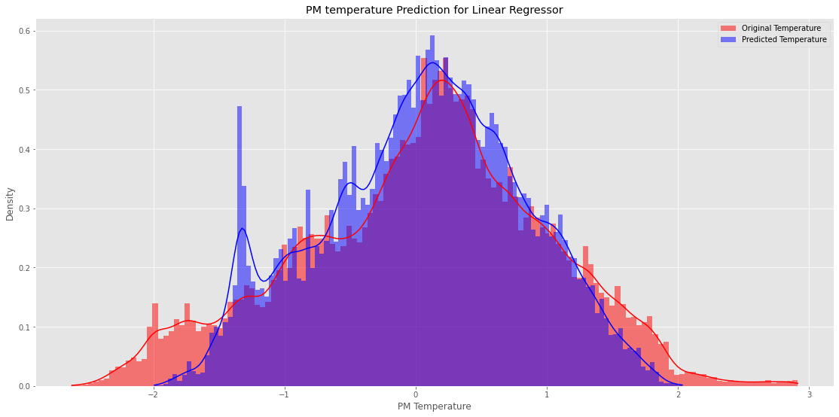
PM Temperature Prediction

Slide 24
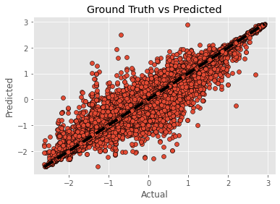
K-Nearest Neighbour Regressor Model
Train Accuracy :99.69888303392678
Test Accuracy :98.9105382602296
Accuracy :98.9105382602296
RMSE Value :0.099308139695351724
MAE Value :0.024408203640237262

Slide 25
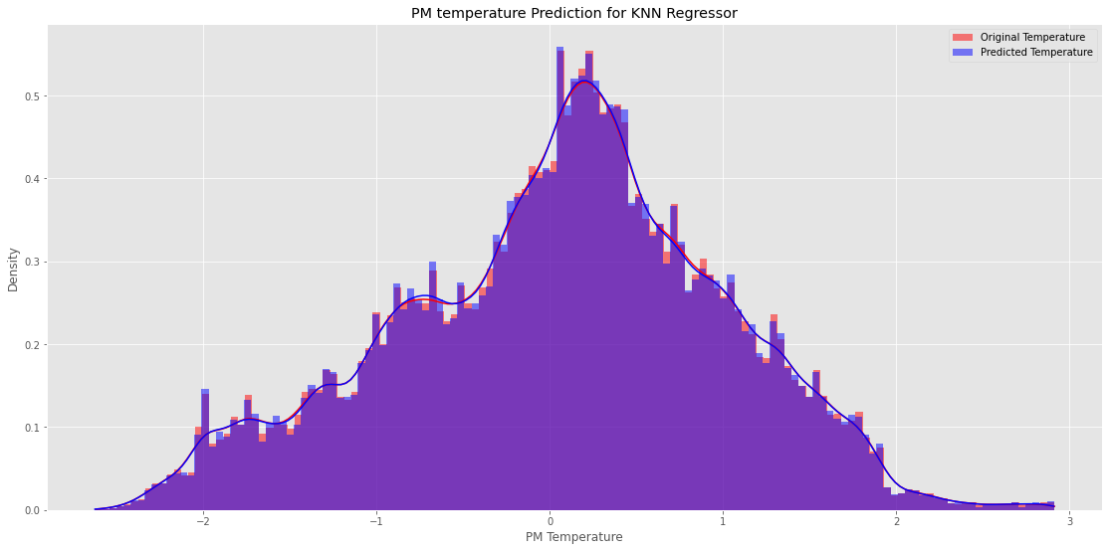
PM Temperature Prediction

Slide 26
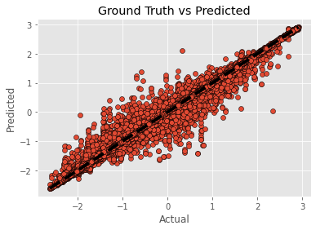
Random Forest Regressor Model
Train Accuracy :99.93915517274219
Test Accuracy :99.57953528671382
Accuracy :99.57953528671382
RMSE Value :0.061694098126383416
MAE Value :0.018174288630832897

Slide 27

PM Temperature Prediction

Slide 28
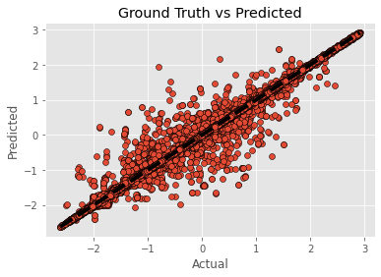
AdaBoost Regressor Model
Train Accuracy :99.99990253996204
Test Accuracy :99.7031189881689
Accuracy :99.7031189886189
RMSE Value :0.05184122304982425
MAE Value :0.009055815832278795

Slide 29

PM Temperature Prediction

Slide 30
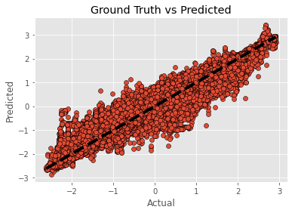
XGB Reggressor Model
Train Accuracy :94.93419499488212
Test Accuracy :94.78863836729774
Accuracy :94.78863836729774
RMSE Value :0.21719731319395916
MAE Value :0.15037702193553845

Slide 31
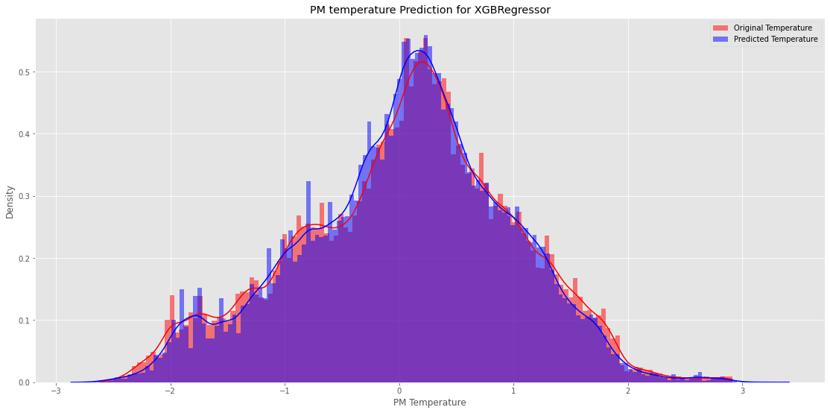
PM Temperature Prediction

Slide 32
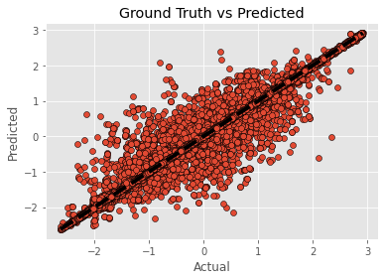
Decision Tree Regressor Model
Train Accuracy : 99.9999955090962
Test Accuracy : 99.1430201739086
Accuracy : 99.1430201739086
RMSE Value : 0.0880773302684
MAE Value : 0.0167386441325

Slide 33

PM Temperature Prediction

Slide 34
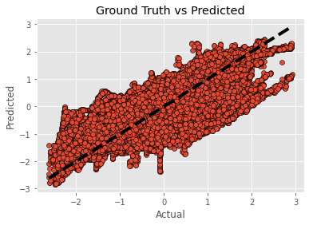
Polynomial Regression Model
Train Accuracy : 71.97606438021356
Test Accuracy : 71.93369402368141
Accuracy : 71.93369402368141
RMSE Value : 0.504047506574355
MAE Value : 0.385485199495337

Slide 35
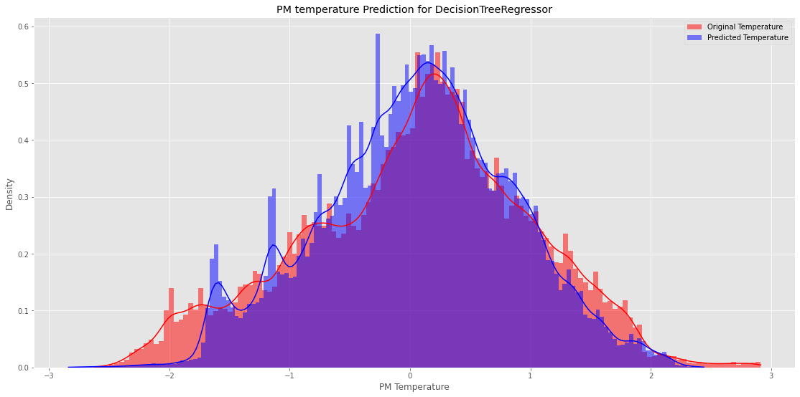
PM Temperature Prediction

Slide 36
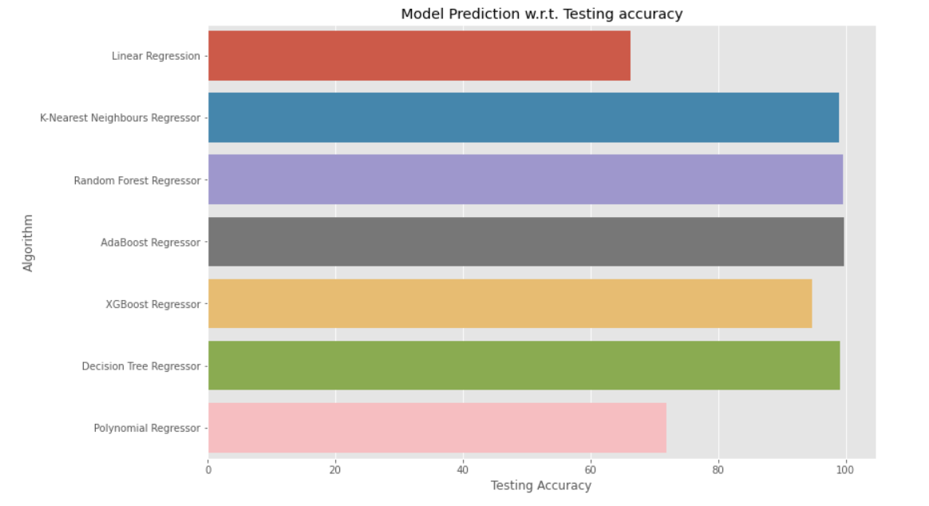
Algorithm Vs Accuracy

Slide 37
Model Deployment

Slide 38
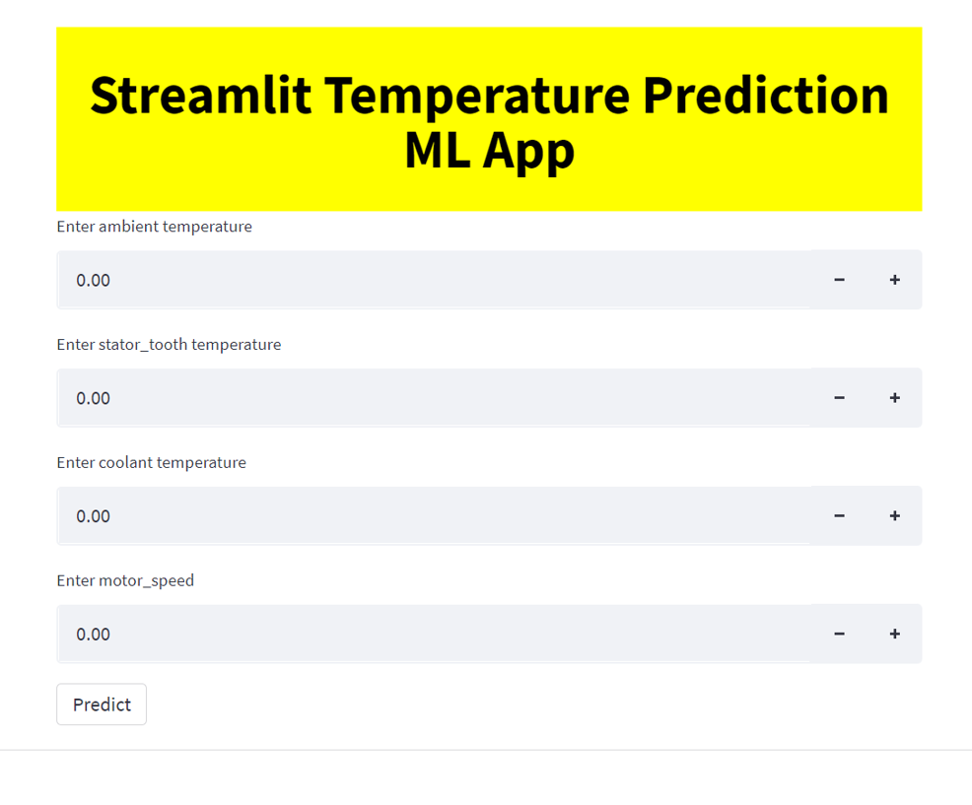
Using Streamlit

Slide 39
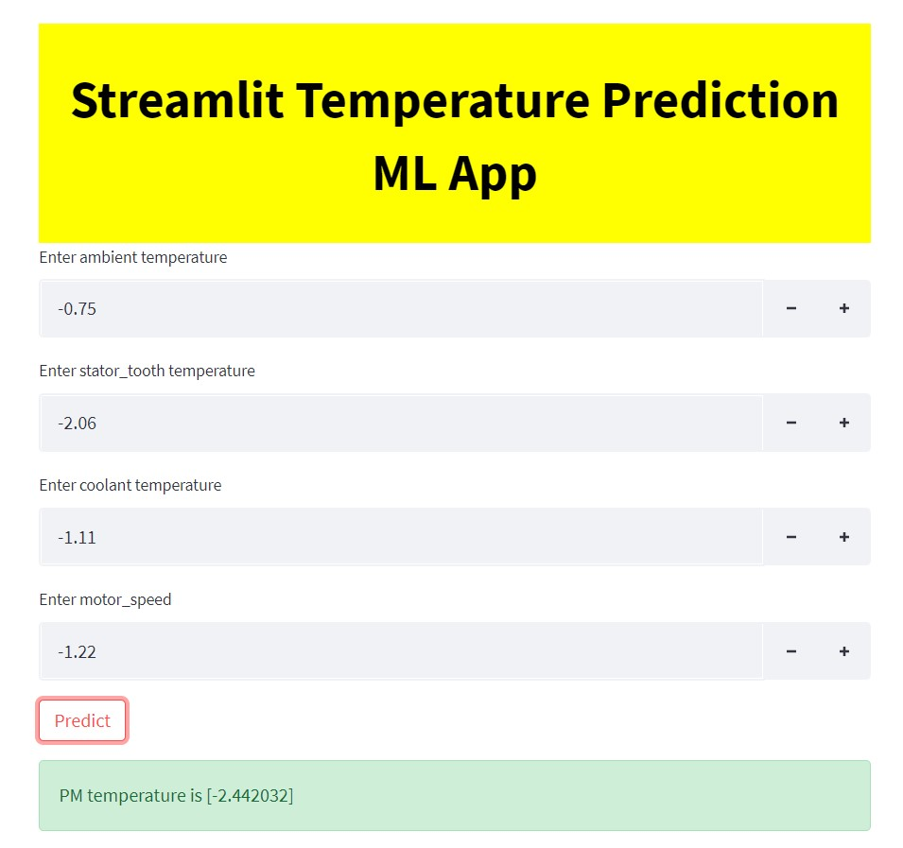

Slide 40
Challenges Faced
Understanding Dataset
Selecting the right features
Designing the right algorithm between space complexity, time complexity and accuracy.
How did we overcome ?
Performed EDA to understand Dataset and relation between all variables.
Performed feature engineering to determine the best features.
Designed various algorithms keeping the X variables same and simultaneously comparing results to select the best algorithm.

Slide 41
THANK YOU

